Slide 1
Addition and Subtraction
There are three ways of representing negative fixed-point binary numbers: signed-magnitude, signed-l's complement, or signed-2's complement.
Most computers use the signed-2's complement representation when performing arithmetic operations with integers.
In this section the addition and subtraction algorithms for data represented in signed-magnitude and again for data represented in signed-2's complement is developed.
Addition and Subtraction with Signed-Magnitude Data
We designate the magnitude of the two numbers by A and B. When the signed numbers are added or subtracted, we find that there are eight different conditions to consider, depending on the sign of the numbers and the operation performed.
These conditions are listed in the first column of Table (shown in next slide). The other columns in the table show the actual operation to be performed with the magnitude of the numbers.
The last column is needed to prevent a negative zero. In other words, when two equal numbers are subtracted, the result should be +0 not -0.

Slide 2
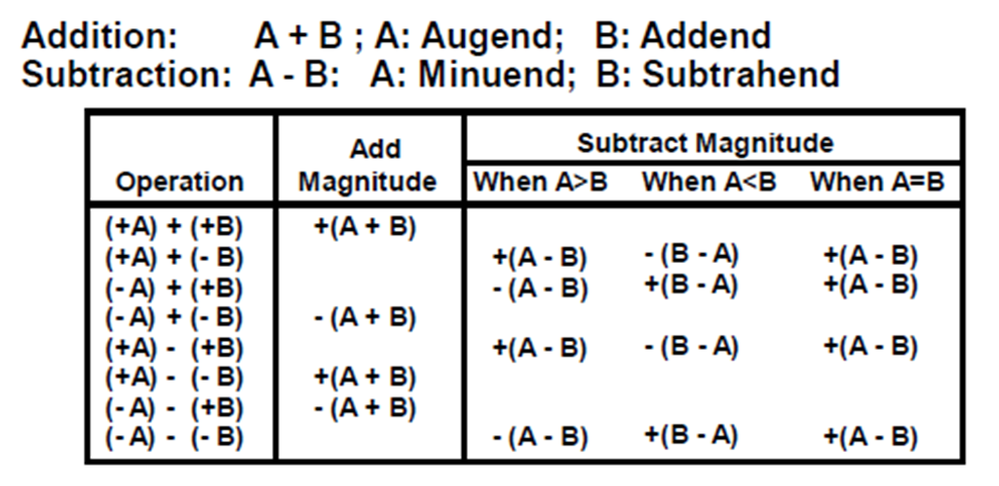
The algorithms for addition and subtraction are derived from the table and can be stated as follows
Addition (subtraction) algorithm: when the signs of A and B are identical (different), add the two magnitudes and attach the sign of A to the result.
When the signs of A and B are different (identical), compare the magnitudes and subtract the smaller number from the larger. Choose the sign of the result to be the same as A if A > B or the complement of the sign of A if A < B. If the two magnitudes are equal, subtract B from A and make the sign of the result positive.

Slide 3
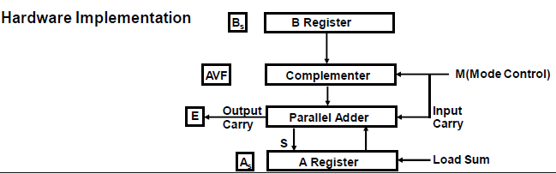
Hardware Implementation
The hardware implementing of the addition and subtraction operations consists of registers A and B and sign flip-flops As and Bs, flip-flops that hold the corresponding signs. Subtraction is done by adding A to the 2' s complement of B.
The output carry is transferred to flip-flop E, where it can be checked to determine the relative magnitudes of the two numbers.
The add-overflow flip-flop AVF holds the overflow bit when A and B are added.

Slide 4
The addition of A plus B is done through the parallel adder. The S (sum) output of the adder is applied to the input of the A register.
The complementer provides an output of B or the complement of B depending on the state of the mode control M.
The complementer consists of exclusive-OR gates and the parallel adder consists of full-adder circuits (as discussed in binary adder and subtractor).
The M signal is also applied to the input carry of the adder. When M = 0, the output of B is transferred to the adder, the input carry is 0, and the output of the adder is equal to the sum A + B.
When M is 1 the l's complement of B is applied to the adder, the input carry is I, and output S = A + B’ + 1. This is equal to A plus the 2's complement of B, which is equivalent to the subtraction A - B.

Slide 5
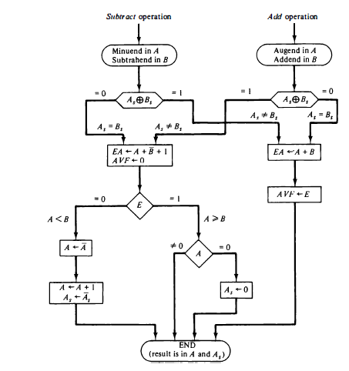
Hardware Algorithm: Flowchart for add and subtract operations

Slide 6
The two signs As, and Bs, are compared by an exclusive-OR gate.
If the output of the gate is 0 the signs are identical; If it is 1, the signs are different.
For an add operation, identical signs dictate that the magnitudes be added. For a subtract operation, different signs dictate that the magnitudes be added.
The magnitudes are added with a micro-operation EA A + B, where EA is a register that combines E and A. The carry in E after the addition constitutes an overflow if it is equal to 1. The value of E is transferred into the add-overflow flip-flop AVF.
The two magnitudes are subtracted if the signs are different for an add operation or identical for a subtract operation. The magnitudes are subtracted by adding A to the 2's complemented B. No overflow can occur if the numbers are subtracted so AVF is cleared to 0.
1 in E indicates that A >= B and the number in A is the correct result. If this numbes is zero, the sign A must be made positive to avoid a negative zero.
0 in E indicates that A < B. For this case it is necessary to take the 2's complement of the value in A. The operation can be done with one micro-operation A A' +1.
However, we assume that the A register has circuits for micro-operations complement and increment, so the 2's complement is obtained from these two micro-operations.

Slide 7
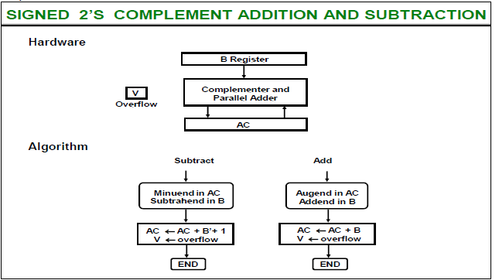
In other paths of the flowchart, the sign of the result is the same as the sign of A. so no change in As is required. However, when A < B, the sign of the result is the complement of the original sign of A. It is then necessary to complement A, to obtain the correct sign.
The final result is found in register A and its sign in As. The value in AVF provides an overflow indication. The final value of E is immaterial.
Addition and Subtraction with Signed-2's Complement Data

